Slide 1
Elections Second Chamber 2023

Slide 2
At the end of this lesson, you will understand…
...why elections for the Second Chamber are needed,
...a bit on how the voting system operates in the Netherlands (more on this in chapter 6 and 7 of your course book),
...the steps political parties take before elections,
...some of the major issues that play a role in these elections and the views that some parties have on these issues.

Slide 3
Why elections on November 22nd?
In July 2023 the cabinet Rutte IV (the fourth cabinet of which Mark Rutte was prime minister) fell.
The four parties in the cabinet (VVD, D66, CDA and CU) couldn’t come to an agreement on how to deal with immigrants coming to the Netherlands. VVD and CDA wanted stricter measures that D66 and CU couldn’t agree with. So, their coalition (cooperation) ended there.
When a cabinet falls. New elections for a Second Chamber are necessary. After those elections there will be a new Second Chamber and a new cabinet can then be formed.

Slide 4
Voting in the Netherlands
Who can vote?
- Dutch nationals (18+) can vote in this election.
Voting system:
System of proportional representation: a voting system where the number of seats a party wins in an election is proportional to the number of votes received. For instance, 10% of the votes = 10% of the seats.
There’s a total number of 150 seats in the Second Chamber.

Slide 5
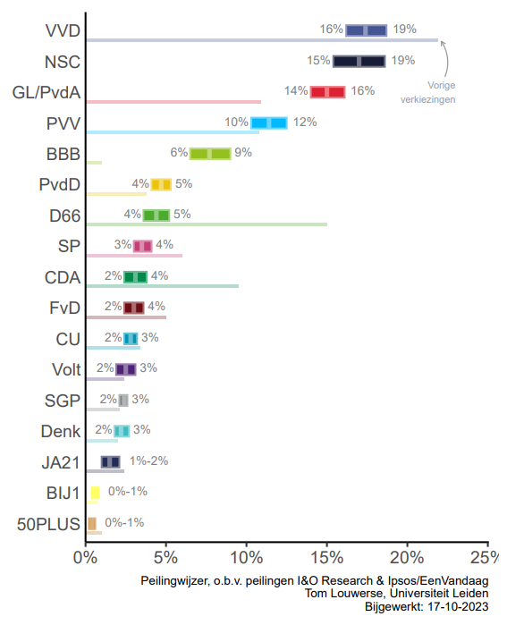
Steps before elections
1) Political parties prepare themselves: Write an election program and register with the Electoral Council and participate in (TV) debates.
2) Voters start thinking: Follow the news / watch election debates and fill out voting guides to see what aligns with their views.
3) Polls become more important: A poll is a survey about what people would vote for 'today.’ Different polls exist; the "Peilingwijzer" combines them.
4)Time to vote.

Slide 6
On Wednesday 22nd
21:00 – Exit poll: survey of polls at polling stations
After 21:00:
Results per municipality
New interim results / exit polls
Somewhere in the night: preliminary election results
Results on Monday, 30th of November by the Electoral Council
an independent body responsible for organizing and supervising elections. It ensures that elections are conducted fairly, accurately, and transparently.

Slide 7
Political parties participating
70 (!) political parties registered to vote.
26 parties will actually participate. Some newcomers:
A green, progressive party with elements from social democracy and liberalism.
A party aimed at young people.
A party that wants to promote...sport!

Slide 8
Political parties participating
Political parties that will participate and had at least 1 seat in Second Chamber:
VVD
D66
PVV
CDA
SP
GL-PvdA
FvD
PvdD
CU
Volt
Ja21
SGP
Denk
BBB
50plus
Bij1
NSC
BVNL

Slide 9
Steps after the elections
After the election of a new Second Chamber on November 22nd a new cabinet will have to be formed.
More on this in chapter 6 of your course book, but in short:
Political parties will look for other parties that can come to an agreement on many or most issues to work together, because...
….if there are parties that can agree on many or most issues and those parties have a majority in the newly elected Second Chamber, they can form a new cabinet together and run the country.

Slide 10
Issues that are important during the debates
As said, the cabinet Rutte IV fell on the issue of how to deal with migration. That will be a topic of debate for the upcoming election as well. But there are other issues that will play a big role:
Climate
The “stikstofcrisis”
The economy
Assignment: On the next slide more on these issues and some viewpoints of political parties. You will be asked to mention advantages and disadvantages of each opinion.

Slide 11
1. Climate: GL/PvdA vs VVD
Climate: What should be done in the Netherlands to deal with the climate crisis?
GroenLinks/PvdA | VVD
Climate neutral (0 CO₂-emission) in 2040 (energy already in 2035). | Climate neutral (0 CO₂-emission) in 2050.
Tough measures for industries to make sure climate goals are met. | Prevent loss of jobs and a shrinking economy as a result of climate policy.
Nuclear energy not mentioned in election programme, but parties said no to nuclear energy in a recent debate. | Use nuclear energy as a source for low CO₂-emission energy.
What are advantages and disadvantages of each of these opinions?

Slide 12
2. “Stikstof”: BBB vs D66
The “stikstofcrisis”: The Netherlands has to lower emissions of nitrogen (stikstof) to preserve nature, but how should we do this (if at all)?
BBB | D66
No focus on lowering emissions, but focus on a broader view of nature. | Go to 50% of current emissions in 2030.
Prioritize building houses, infrastructure and helping farmers. | Make sure nature isn’t affected by high emissions.
What are advantages and disadvantages of each of these opinions?

Slide 13
3. Economy: SP vs BVNL
The economy: What should be done to fight growing poverty and inequality? And at the same time: How can the Dutch economy stay strong?
SP | BVNL
Step out of the euro. | Schiphol is allowed to grow.
Cheaper public transportation. | Free public transportation for everyone.
Help smaller entrepreneurs, not big companies. | Get rid of 20% of the civil servants. Make them available for the real economy.
Taxes (in general): Should go up for the rich and big companies to help others. | Tax (in general): Should in many cases go down in order to promote the free market.
What are advantages and disadvantages of each of these opinions?

Slide 14
Issues that are important during the debates
You were asked to give advantages and disadvantages for several political ideas that different parties have.
You might realize now that in politics all decisions have upsides and downsides. Some people, groups or companies will benefit and other will not.
Making political choices is therefore very difficult: Whatever you do, it will always benefit some and hurt others.
The result of the elections will show us in which direction people think the Netherlands should move!

Slide 15
Want to learn more?
If you want to learn more about the parties and views they have, try https://www.kieskompas.nl
This is one of several websites that provides an advise for people on what to vote. Compare your result to that of your classmates!
The advantage of using this website and not another, is that it uses the same set of axes that we use in our course book. Safe the result of this test for a while, it will help you later this year to understand your political preference:
- One axis (progressive-conservative) is about cultural issues.
- One axis (left wing-right wing) is on economic issues.

